Slide 1
MASTERPIECES OF WESTERN ART Art Humanities W1121 Section 15
Bernini
(Part 2)

Slide 2
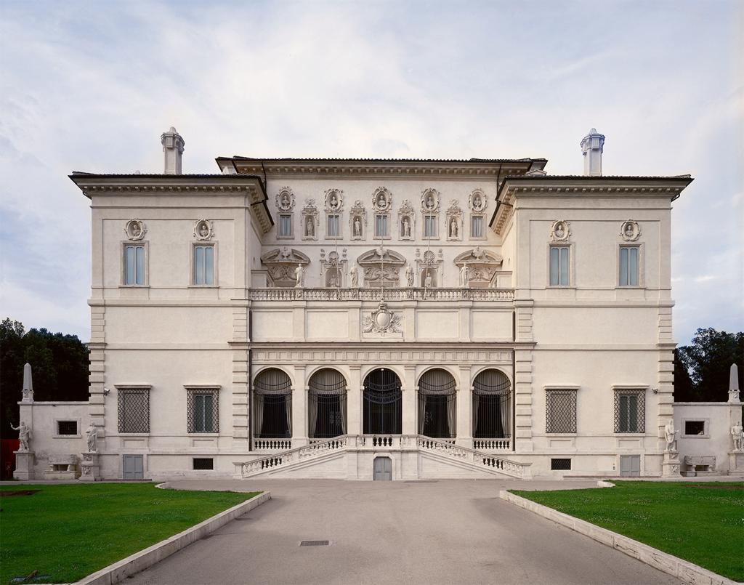
Borghese Villa, 1612-13, Rome

Slide 3
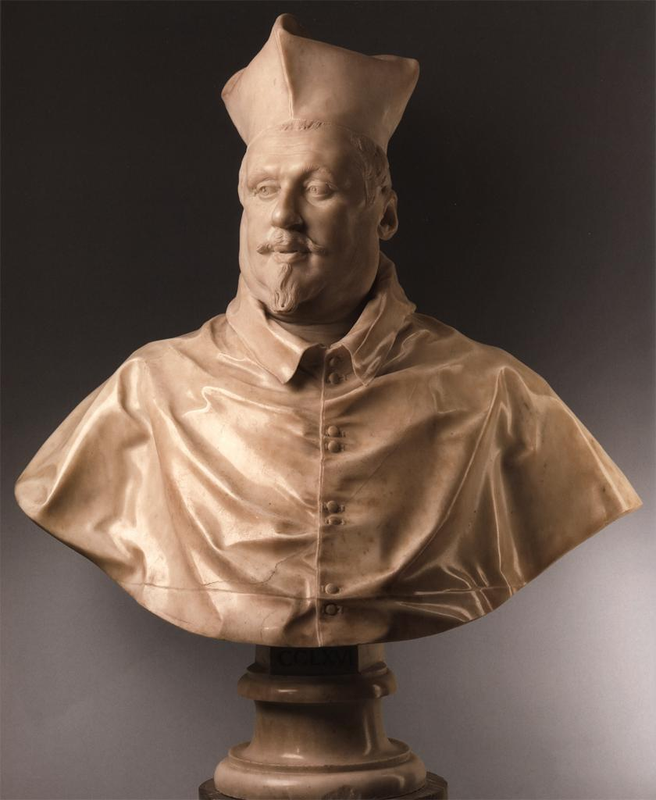
Bernini
Portrait Bust of Cardinal Scipione Borghese
1632

Slide 4
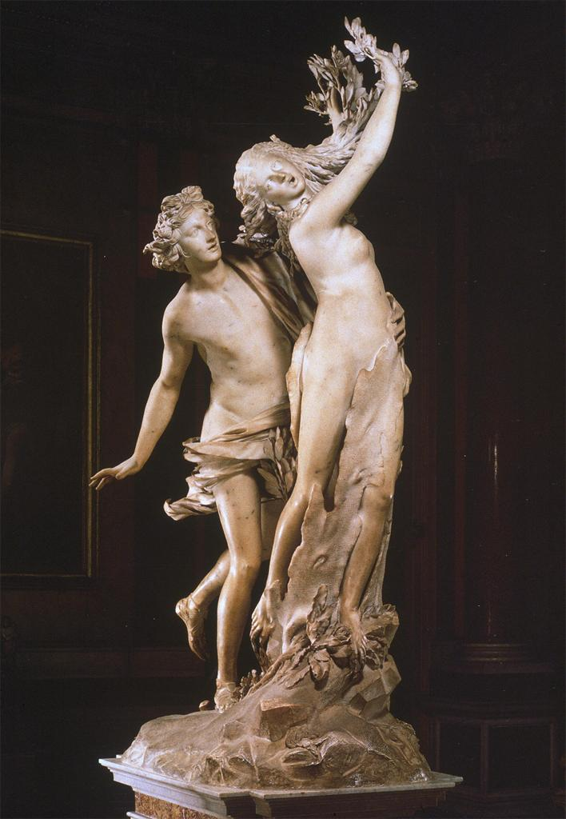
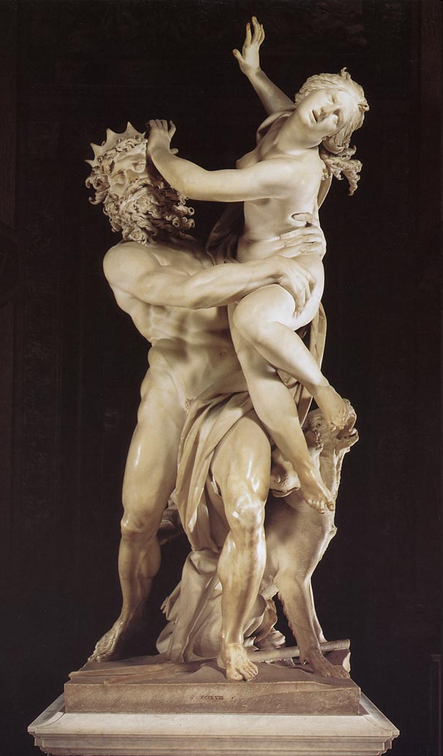
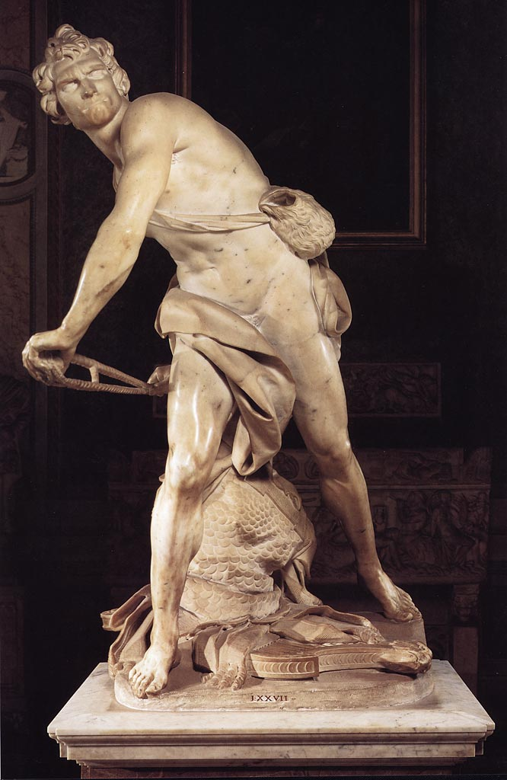
Bernini
David
1623-24
Apollo and Daphne
1622-25
Pluto and Persephone
1622-25

Slide 5
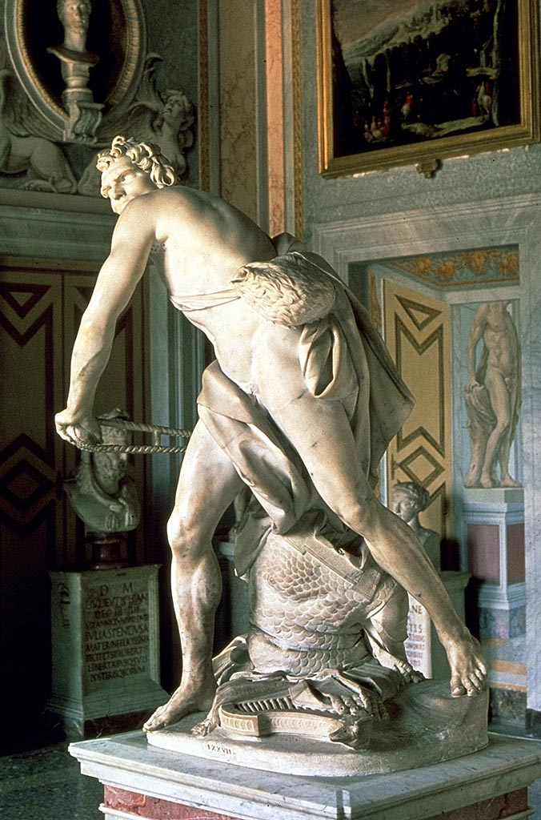
David in the Borghese Gallery today

Slide 6
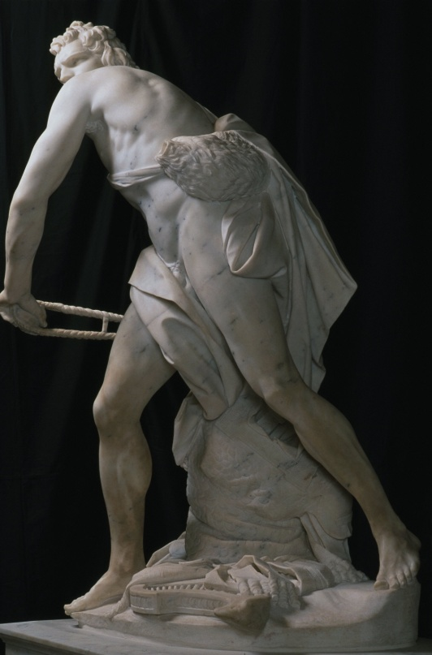
David

Slide 7
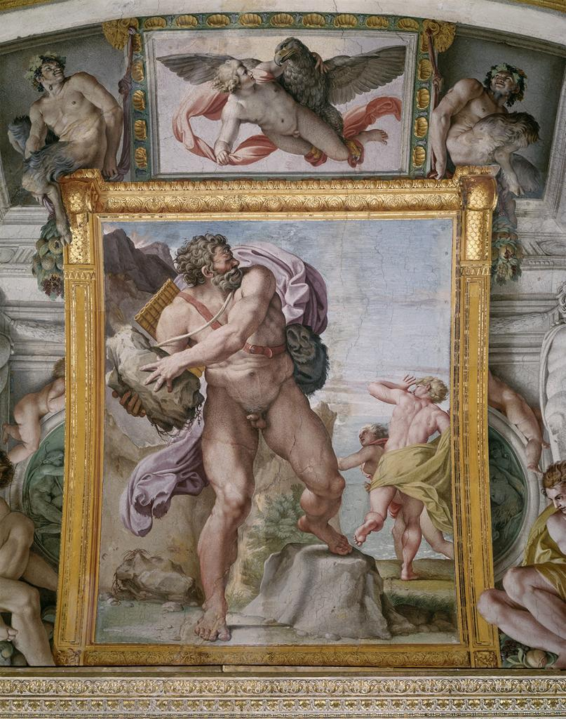
Annibale Carracci
Polyphemus Attacking Acis and Galatea
Fresco, c. 1596-97, Farnese Palace, Rome

Slide 8
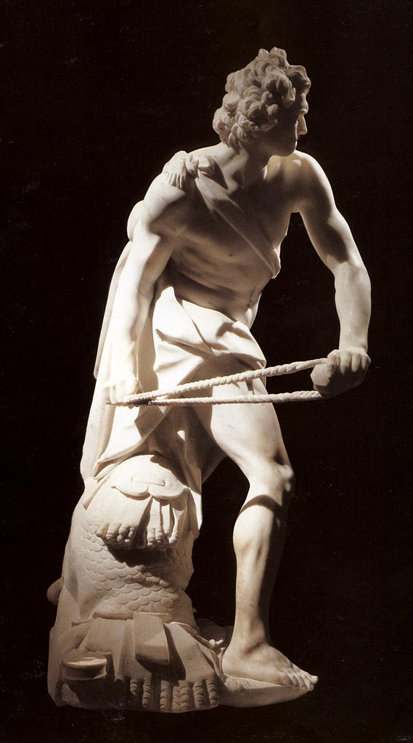
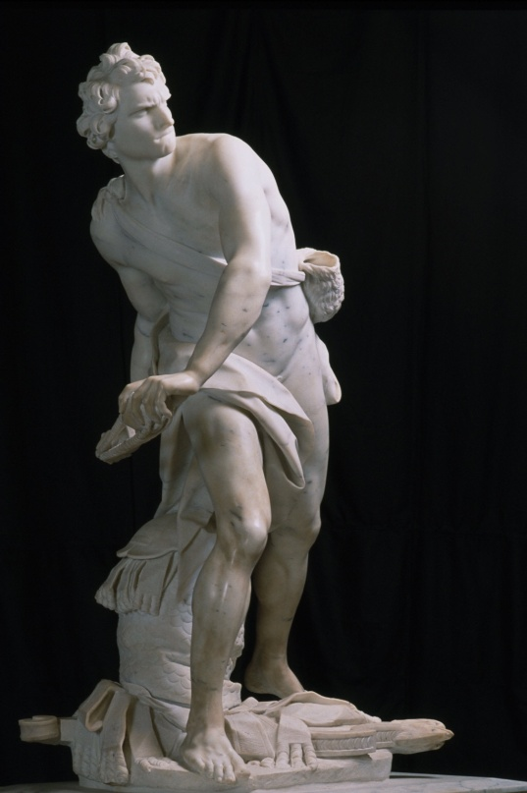
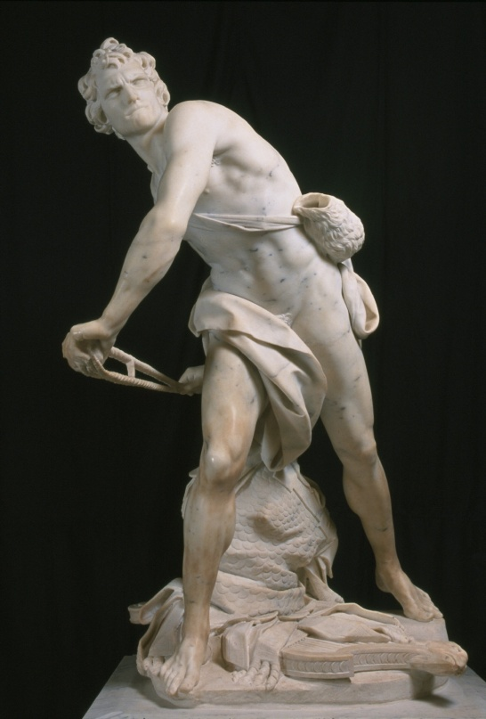

Slide 9
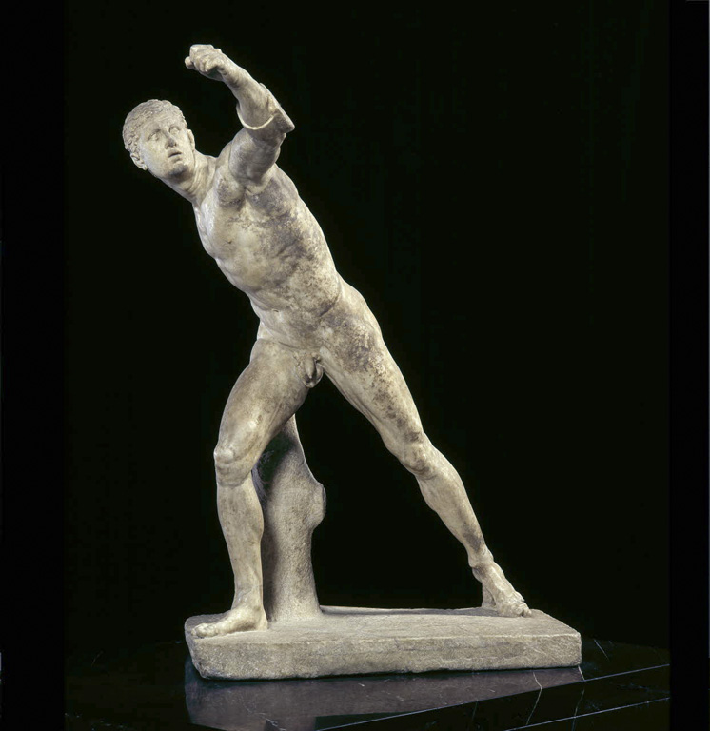
Agasias
Borghese Gladiator
1st century B.C.

Slide 10
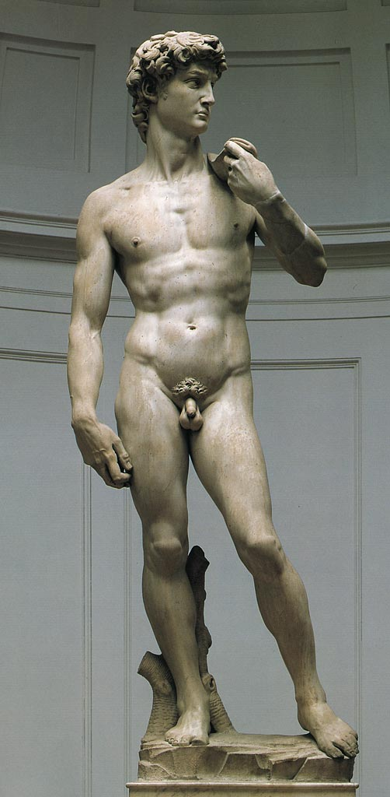

Slide 11
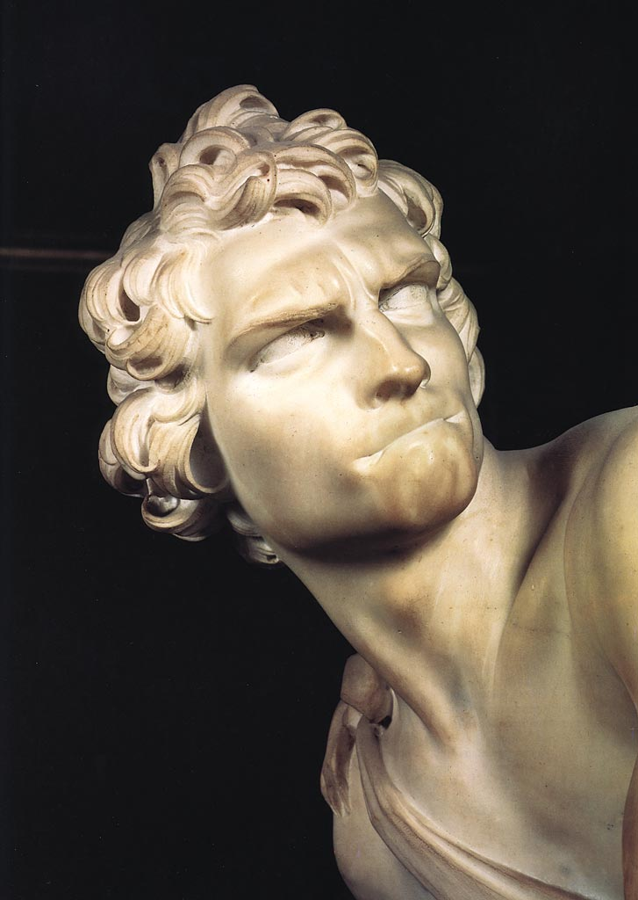
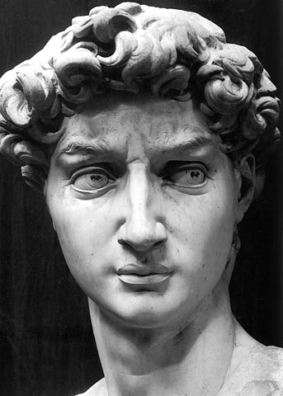

Slide 12
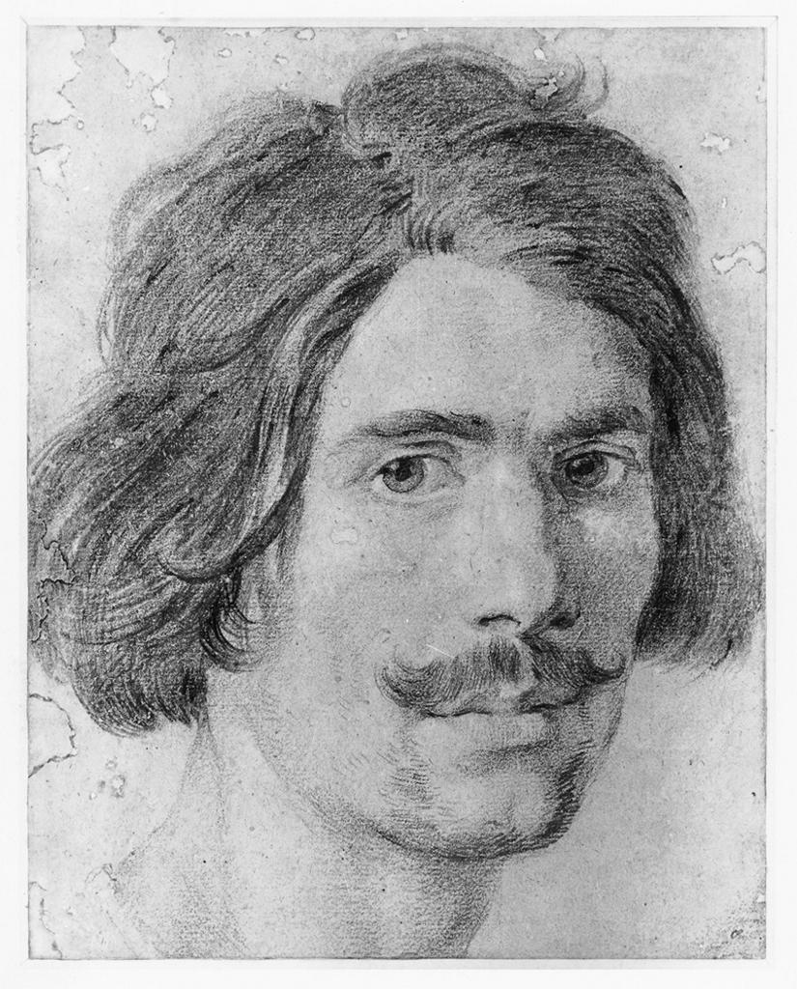
Bernini
Self-portrait
mid-1620s

Slide 13
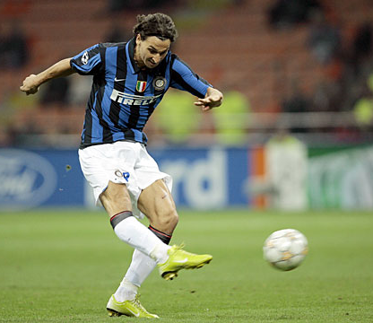

Slide 14
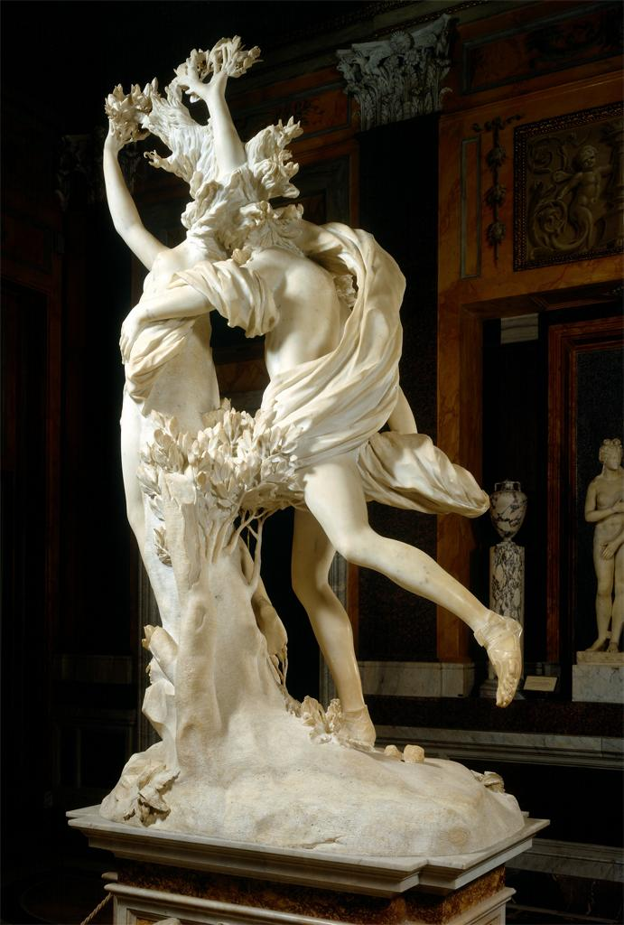
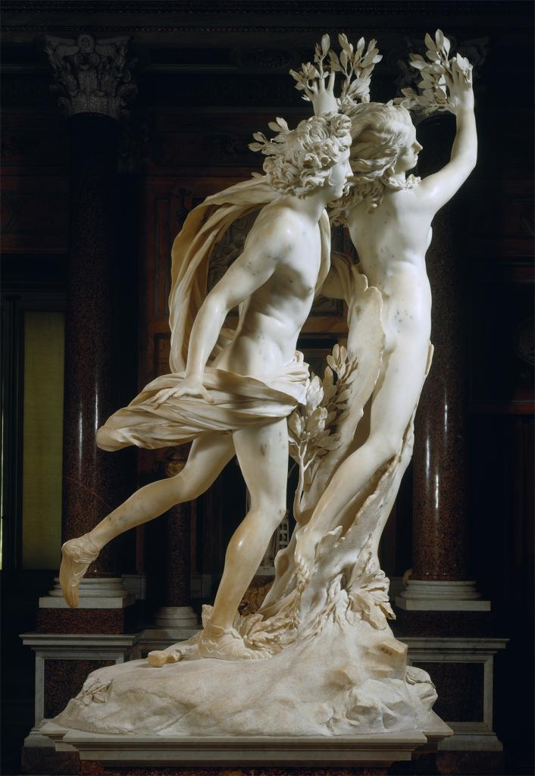
Apollo and Daphne

Slide 15
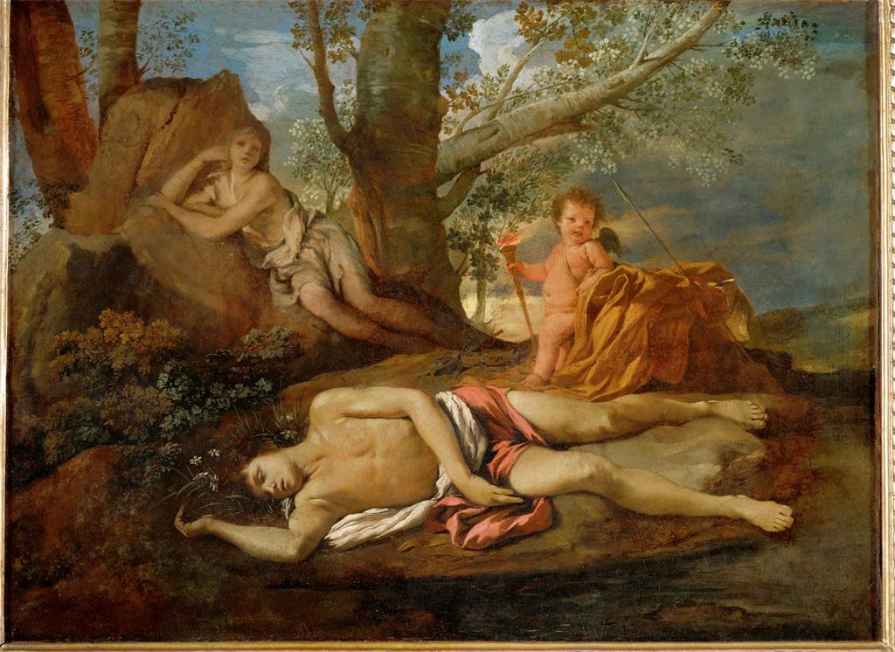
Nicolas Poussin, Echo and Narcissus, c. 1630

Slide 16
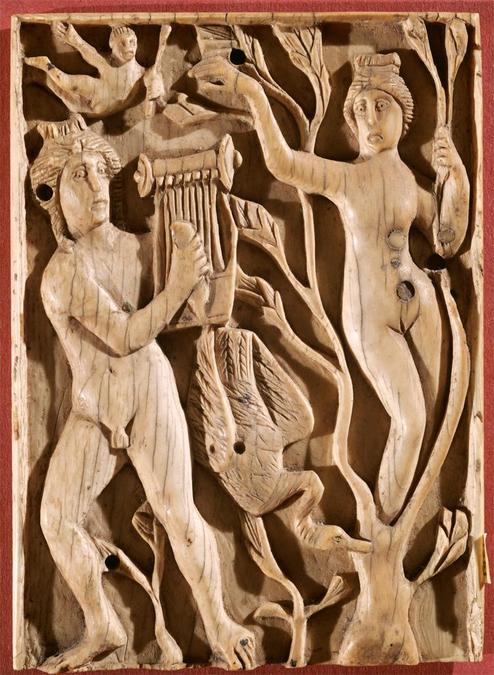
Apollo and Daphne
Late 5th – early 6th century AD
Coptic ivory

Slide 17
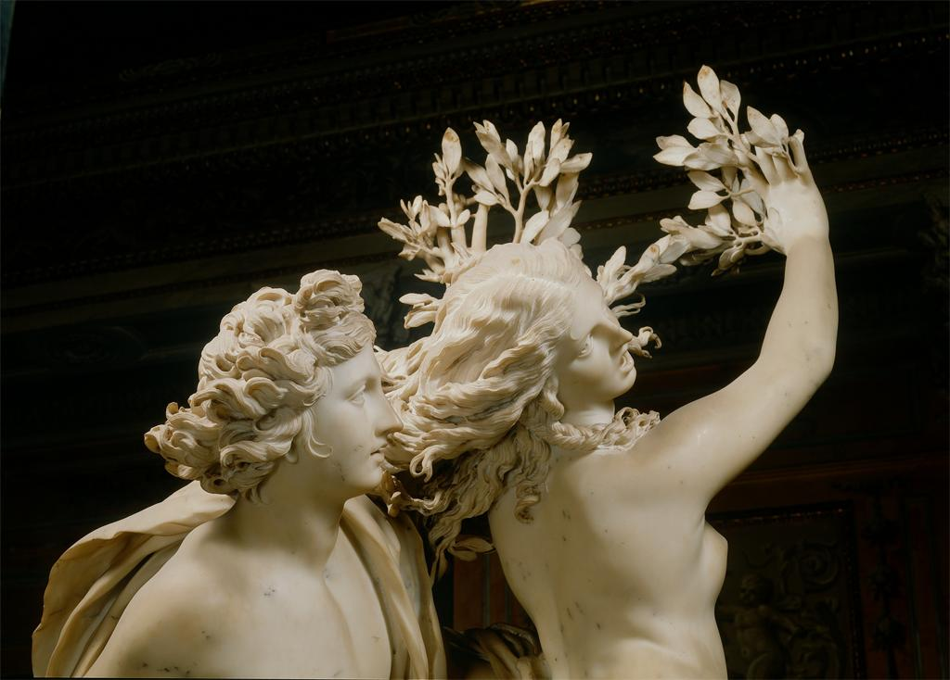
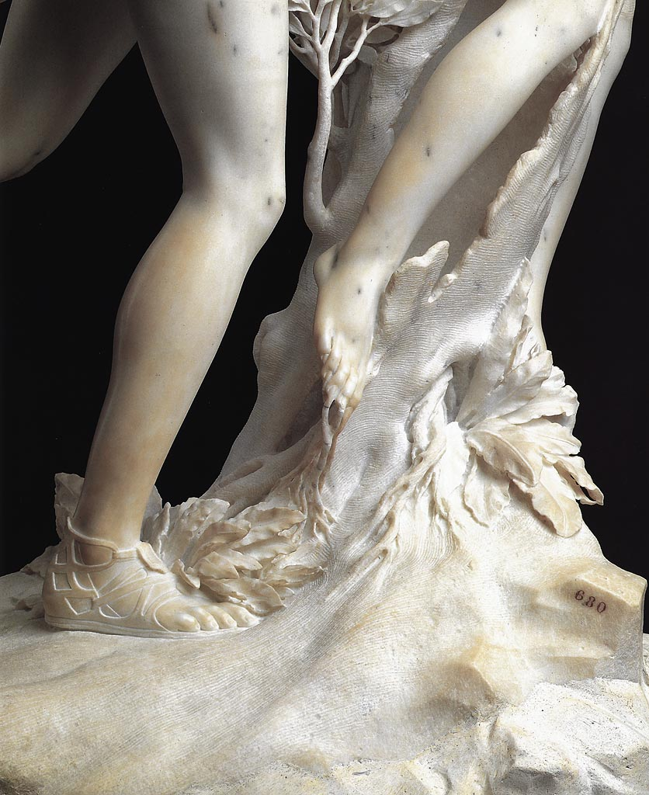

Slide 18
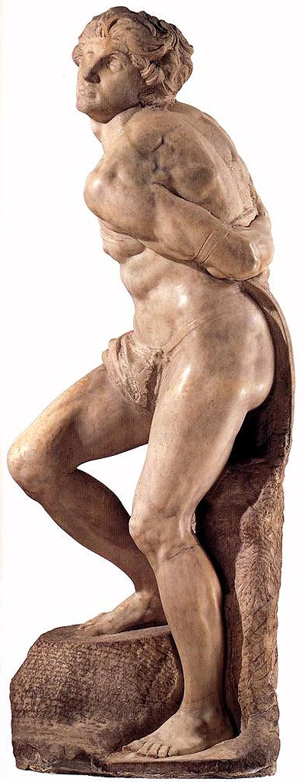
Michelangelo
Rebellious Slave
c. 1515

Slide 19
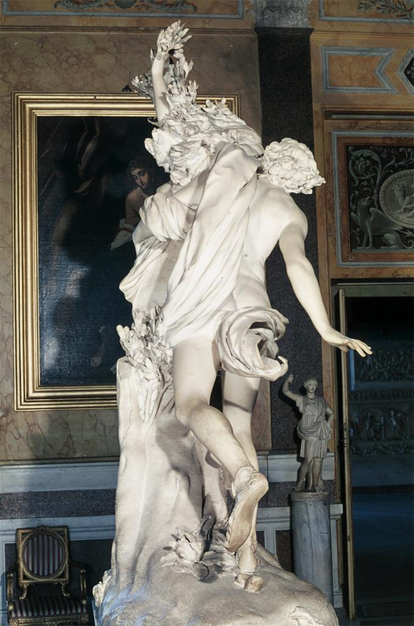

Slide 20
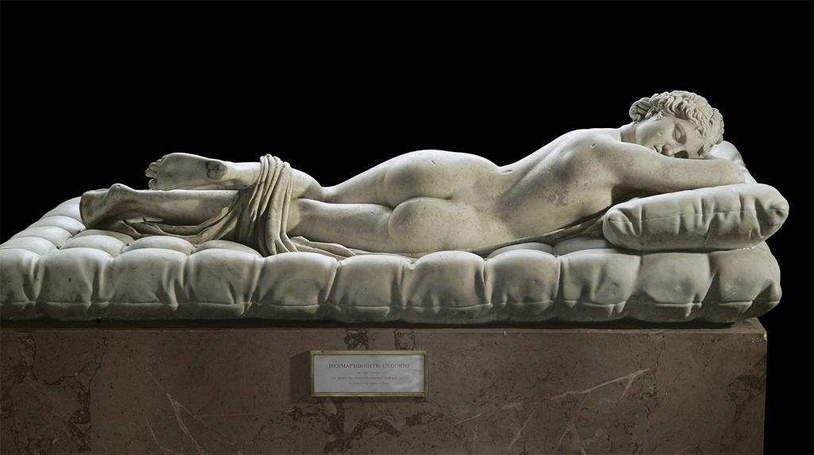
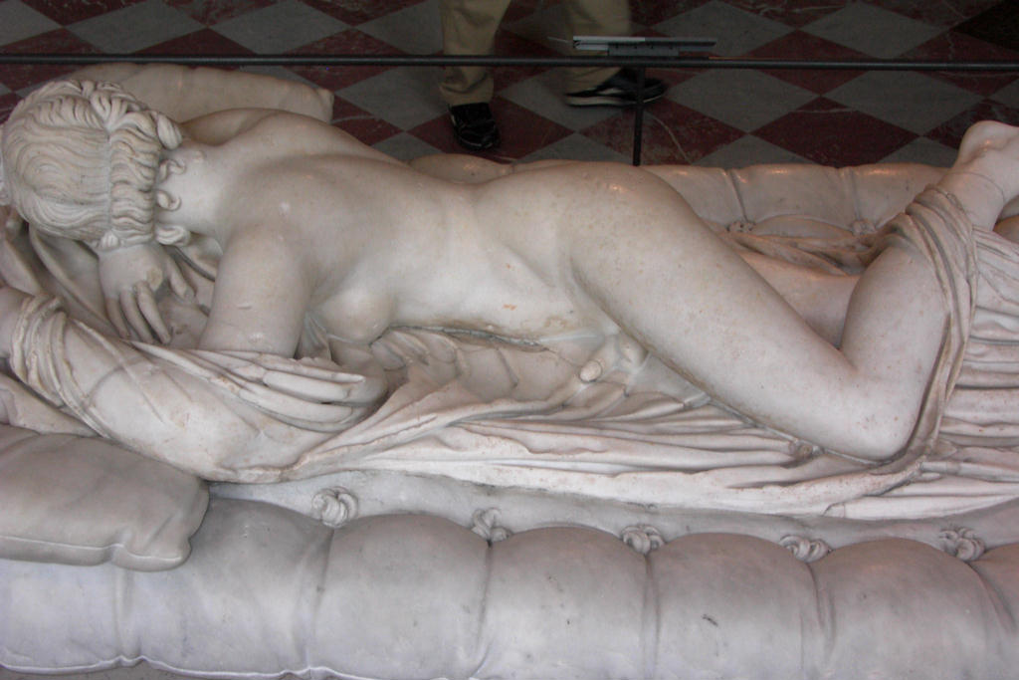
Sleeping Hermaphrodite
2nd c. AD copy of a 2nd c. BC original
Cushion and mattress by Bernini
Former collection of Cardinal Scipione Borghese

Slide 21
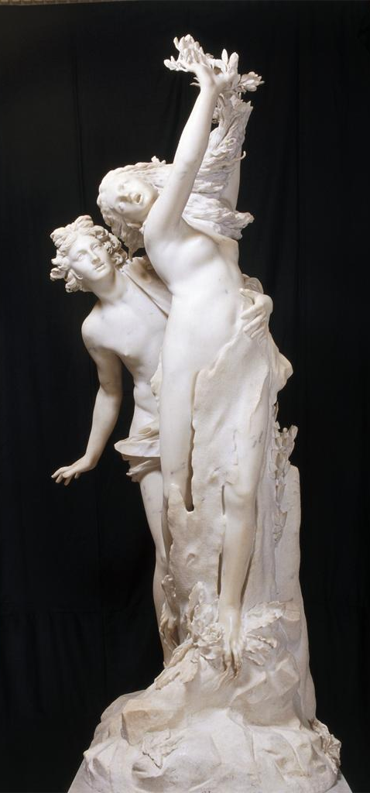

Slide 22
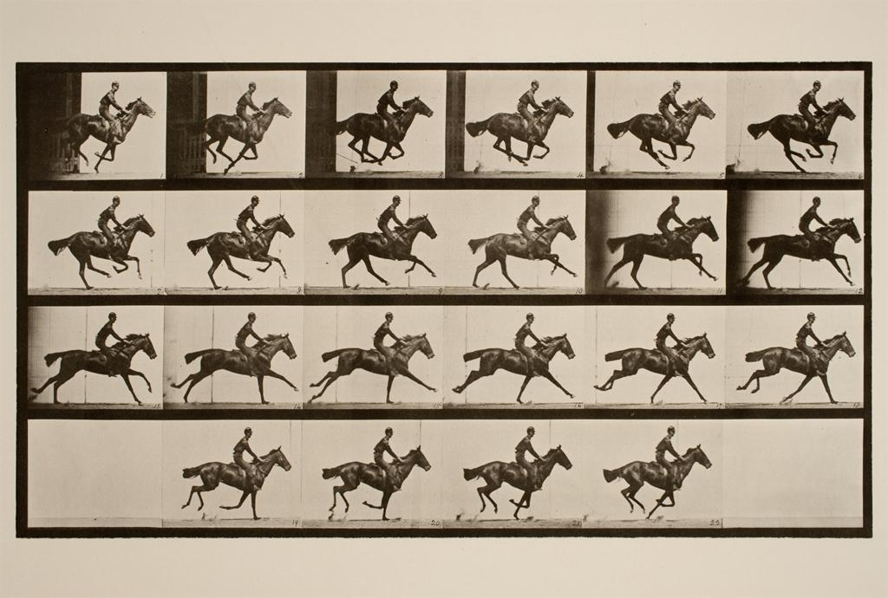
Muybridge, Gallop, c. 1884-87
Collotype print

Slide 23
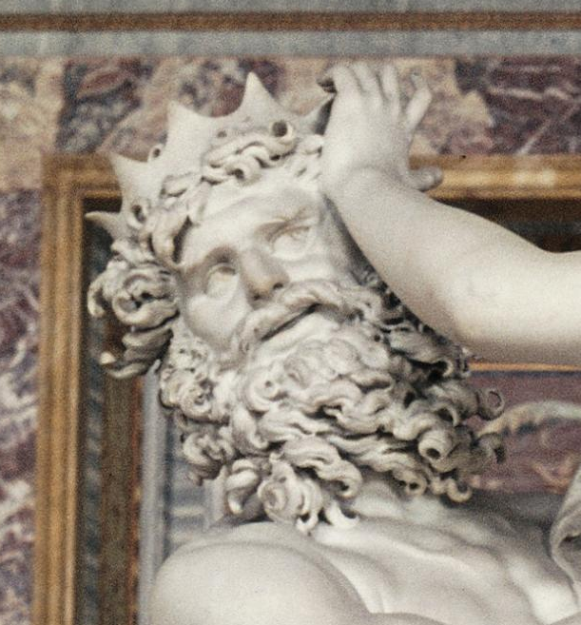
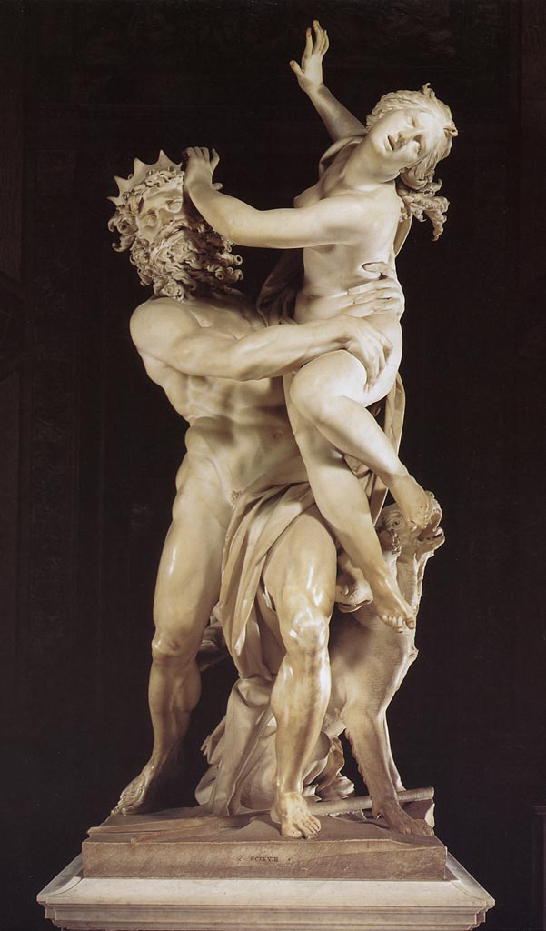
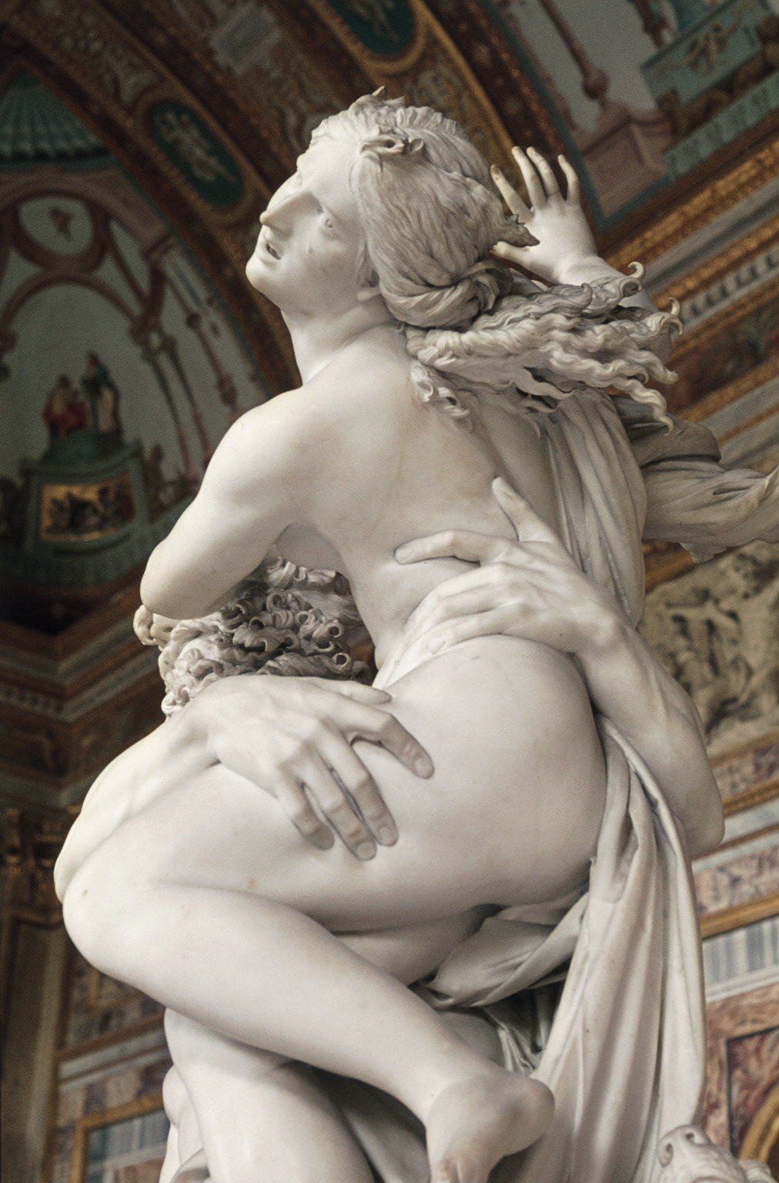
Pluto and Persephone

Slide 24
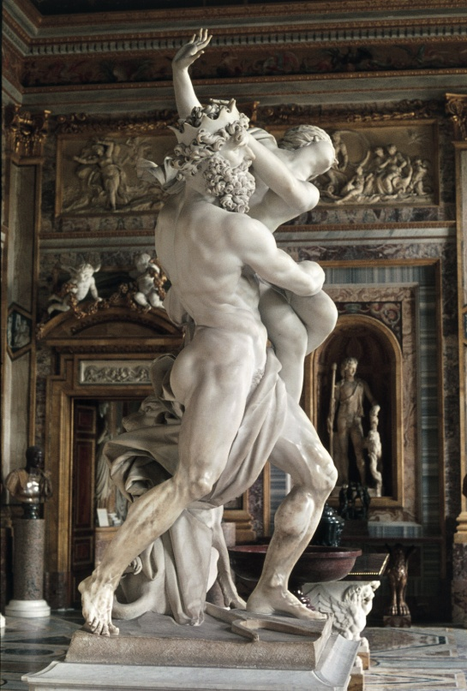
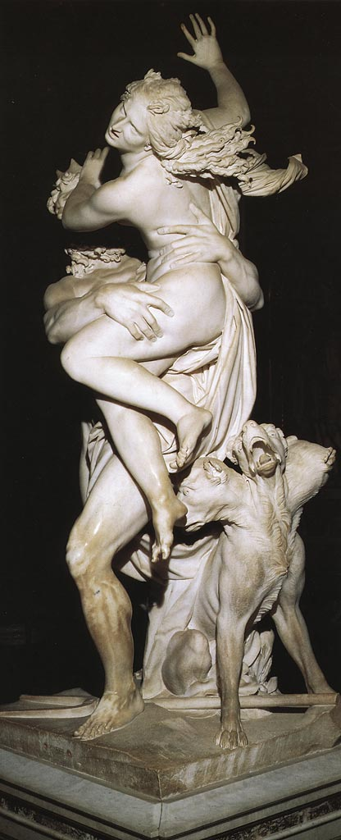

Slide 25
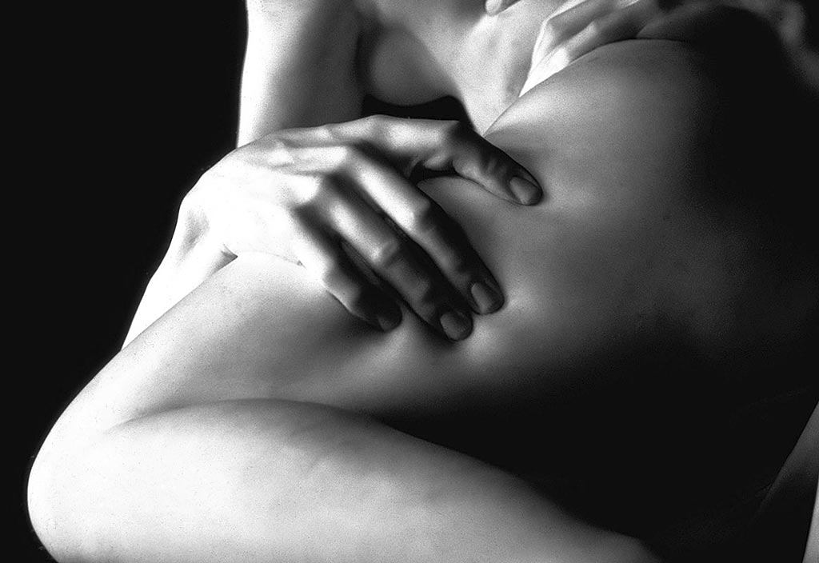

Slide 26
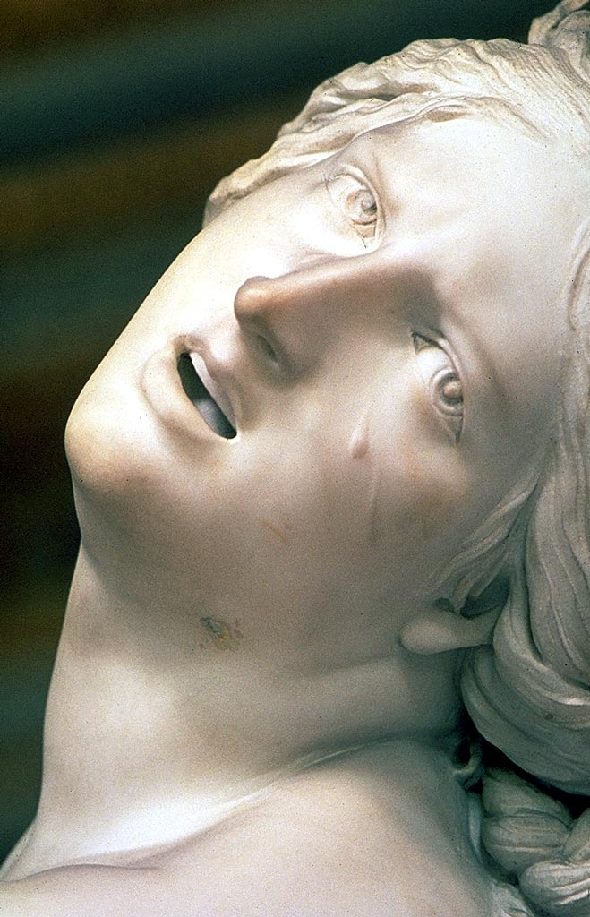
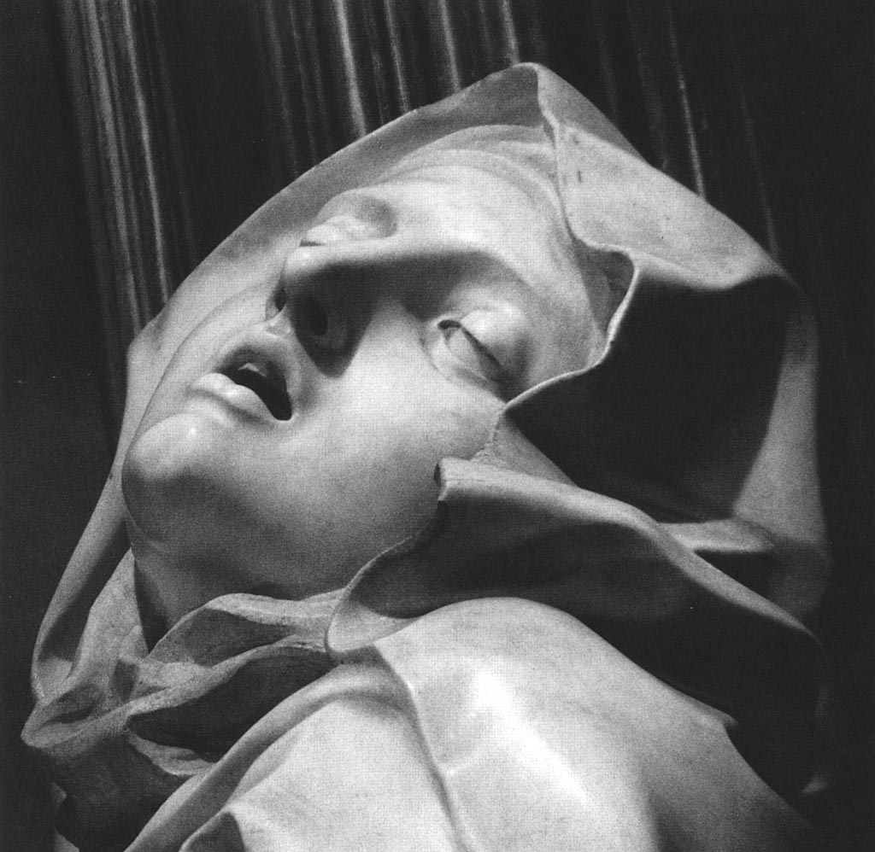

Slide 27
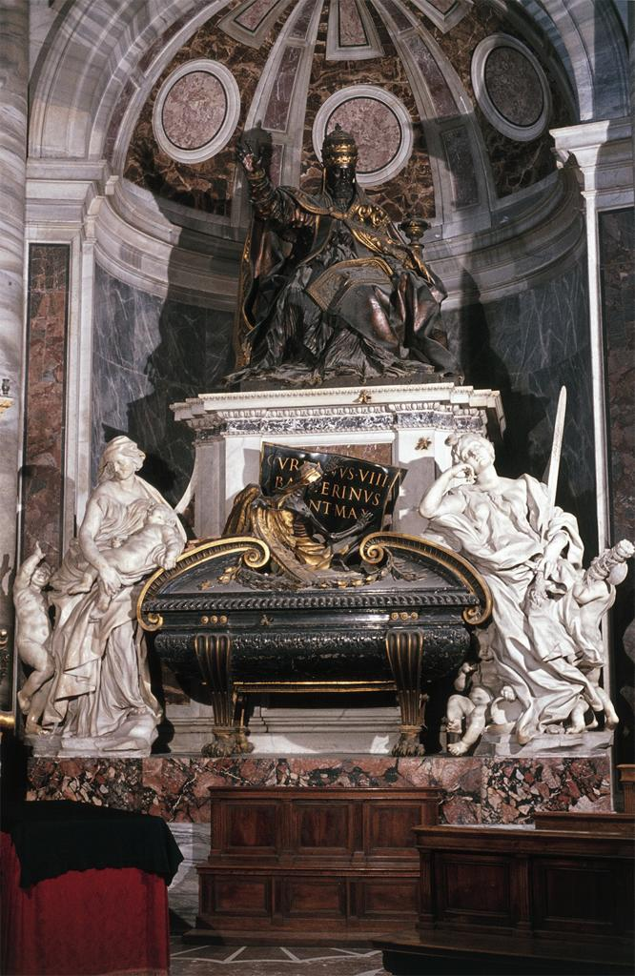
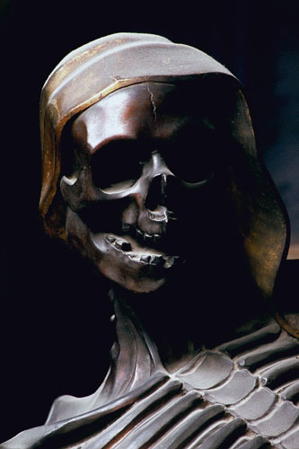
Bernini
Tomb of Urban VIII
1628-47

